Slide 1
IELTS Writing Task 2 (Academic) Introduction

Slide 2
IELTS Writing Task 2 (Academic)
IELTS Writing Task 2 requires you to write an essay in response to a statement, or premise. You must read the question carefully so that all parts are answered.
For example, in the question you must do 3 things to achieve a higher band, showing the examiner that you are addressing all parts of the task.

Slide 3
IELTS Writing Task 2: 8 steps towards a band 8
In IELTS Writing Task 2, you will need to write an essay. IELTS Experts have walked through 8 steps that can help you get a band 8. Take a closer look at the assessment criteria, how to structure your essay, and common mistakes to avoid.
To achieve a band 8 in IELTS Writing Task 2, you will need to produce an essay that contains all the positive features contained in the band 8 writing assessment criteria. Let's take a look at these in the table below.

Slide 4
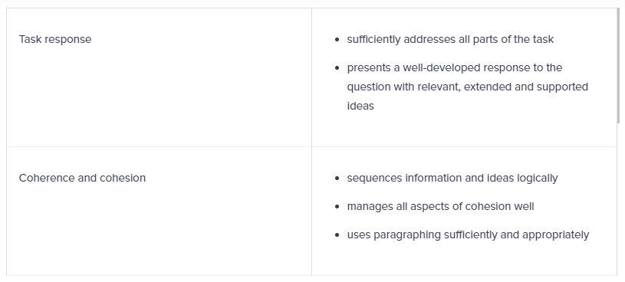

Slide 6
Using the band descriptors as a guide we are going to go through the 8 steps to get you on your way to a band 8 in Writing Task 2.
We will start with the task response before moving through all the criteria to show you what an examiner will be looking for in your response.

Slide 7
Step 1: Answer is relevant to the question
Answer what you have been asked in the question. Don’t produce an essay that is close to a topic you have previously prepared. Make sure your examples and ideas are relevant. If you generalise too much and are not specific enough this will affect how your ideas are presented to the examiner.
Do
Make sure your ideas are directly related to the question
Use ideas and examples that you are familiar with, and that relate directly to the topic
Extend your answer to include a number of ideas that will support the question.
Don't:
Include irrelevant information
Over-generalise
Produce a memorised essay
Present ‘recent’ research or statistics related to the topic “At least 41% of all men…”

Slide 8
Step 2: Answer all parts of the question.
You must read the question carefully and decide how many parts are in it. You must answer all parts of the question to reach a band 6 or higher.
Let’s look at some example IELTS question prompts and see how many parts are in each, if you need to present your opinion. Remember, it is very important to present a clear position when answering the statement to show that you understand the question being asked and to keep that position clear throughout the essay.

Slide 9
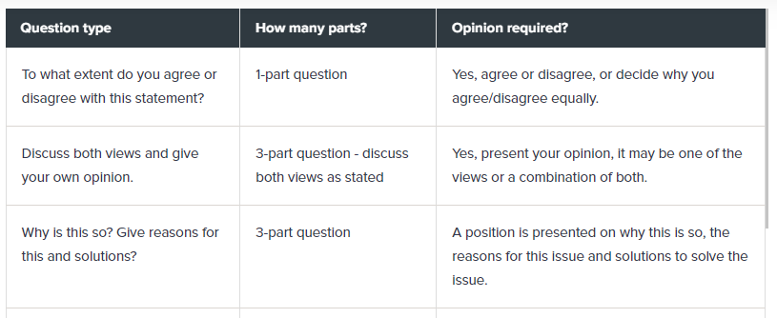

Slide 11
Do:
Read the question carefully and decide how many parts are in it
Present your opinion and support it throughout the whole essay
If asked to present both views, make sure each view is presented equally (similar paragraph length)
Watch for plurals. If you are asked to give ‘advantages’, you must present a minimum of 2
Watch for ‘and’. You may need to comment on more than one element
Write more than 250 words.
Don’t:
Ignore parts of the question
Assume that your opinion is clear, use the first person to ensure the examiner knows it’s your opinion ‘I think’
Tell the examiner what you are going to say and what you have said
Produce a short essay.
ch

Slide 12
Do:
Read the question carefully and decide how many parts are in it
Present your opinion and support it throughout the whole essay
If asked to present both views, make sure each view is presented equally (similar paragraph length)
Watch for plurals. If you are asked to give ‘advantages’, you must present a minimum of 2
Watch for ‘and’. You may need to comment on more than one element
Write more than 250 words.
Don’t:
Ignore parts of the question
Assume that your opinion is clear, use the first person to ensure the examiner knows it’s your opinion ‘I think’
Tell the examiner what you are going to say and what you have said
Produce a short essay.

Slide 13
Step 3: Organise your essay logically, with clear progression using linking phrases
Ideas must be expressed and ordered clearly - starting with an introduction and moving through to a conclusion.
If you are asked to present both views and your opinion, state your opinion at the beginning of the essay and then move on to present both views. You can then come back to your own opinion and then conclude the essay. This is a logical way to present these ideas.

Slide 14
Do:
Use a range of linking words and phrases, but don’t overuse them
Use adverbial phrases, rather than single basic linkers
Use referencing and substitution to avoid repetition (this/them/the issue/the problem)
Use punctuation to make your writing coherent
Make sure your ideas are sequenced correctly
Make sure your ideas are logical and easy to follow
Use a separate paragraph for the introduction and the conclusion
Use one paragraph for each idea or topic area.

Slide 15
Don’t:
Overuse basic linking words like firstly (instead, try using ‘The first reason for/ The primary reason for this’)
Start every sentence with a linker (Try to put it in the middle of a sentence. E.g. “Some people believe, however, that individuals must also take responsibility for the environment” or “I believe, on the other hand, that individuals do have a responsibility to…”)
Use numbers, symbols or abbreviations (1, 2, etc, &, +)
Use headings or subheadings
Underline words or phrases
Use one-sentence paragraphs
Start every sentence with a linking device.

Slide 16
Step 4: Organise your essays into paragraphs
Use paragraphs to organise your essay into clear parts. Make sure each paragraph contains a clear and developed topic with a minimum of two sentences.
You can use the acronym “PEEL” when writing your essay:
Point – introduce your topic or topic sentence
Example – an example that supports your point
Explain – why this evidence supports your point
Link – transition to the next topic or paragraph
You must use enough paragraphs to clearly show a structured response. This will show that you can organise and present your thoughts and ideas logically.

Slide 17
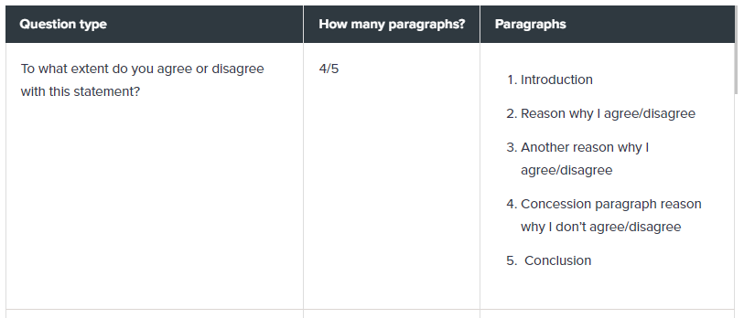
Here are some ideas on how many paragraphs you could include in an essay:

Slide 18
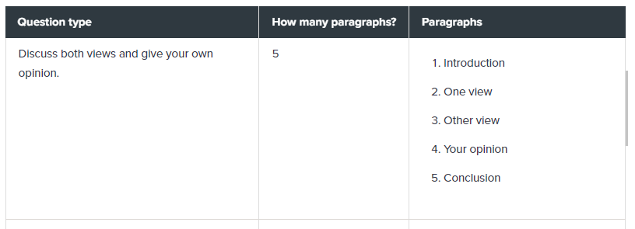

Slide 20
Do:
Use paragraphs
Use linkers between and within your paragraphs
Leave a space between each paragraph (a line)
Use a paragraph for each topic
Use an introduction and a conclusion.
Don’t
Use single-sentence paragraphs
Use very long paragraphs that cover a whole page (IELTS on paper)

Slide 21
Step 5: Use less common vocabulary and spell it correctly
You will see in the band descriptors that a band 8 writer skillfully uses uncommon lexical items. When we learn a language, we use common and uncommon terms. Common terms are words and phrases we use every day to refer to personal experience and daily habits. Uncommon terms are used when we discuss specific topics or when we use idiomatic language (phrasal verbs).
Words that are old-fashioned and not used in everyday speech should not be used. If you choose a synonym, the meaning must be the same and must not alter the idea being presented. For example, adolescent/teenager have close meaning and can be used interchangeably, however, toddler/baby have quite different meanings.

Slide 22
Collocation is also mentioned in band 8, and it is assumed that you know which words go together, and which words are suitable to use for different topics.
If you are discussing child crime, you could use the term ‘minor’ as this is a legal term used to describe children under the age of 18.
If you use phrasal verbs, make sure that you are using the correct preposition as it can change the meaning:
throw out/away = discard
throw up = vomit/get sick
Idioms (cultural language) should only be used if you understand them completely and if they fit the topic you are discussing.

Slide 23
Do:
Use precise word choices
Use language that we use in everyday speech
Use words that you understand
Use words and phrases that are related to the topic
Use collocation and phrasal verbs (words that go together naturally – environmental
pollution | major issue | promising future)
Don’t
Make spelling mistakes
Make typos
Mix up American and British spelling (You should use one or the other)
Use a word if you don’t understand it or cannot spell it.
Use imprecise words like ‘stuff/thing’

Slide 24
Don’t
Use slang like ‘gonna’
Use old-fashioned language [the masses| denizens | myopic view | Hitherto]
Overuse synonyms, one is enough
Use idioms/clichés
Use contractions (can’t, doesn’t)

Slide 25
Step 6: Don’t use memorised language, phrases, or examples
Don’t use any memorised language, phrases or examples throughout your essay. They are easy for examiners to spot and don’t demonstrate your ability to write fluently.
Overused phrases, idioms, proverbs and clichés should also be avoided, again, they are often used when speaking. These include phrases like:
The grass is always greener on the other side
Love is blind
Off the top of my head
Old is gold
A friend in need is a friend indeed

Slide 26
Additionally, the following terms should not be used when writing as they are vague and do not address a task appropriately. You should always be using clear language and make appropriate word choices that will express your ideas clearly.

Slide 28
Step 7: Use a variety of complex sentence structures
At band 8 it is expected that you can use a wide range of structures accurately to present your ideas and opinion. Show the examiner that you can use a wide range of structures and make sure your sentences are error-free.
It is important to use a mix of complex and simple sentences. But remember, your complex sentences should not be long and complicated.
Your punctuation needs to be accurate, using capitalisation, commas and full stops correctly.

Slide 29
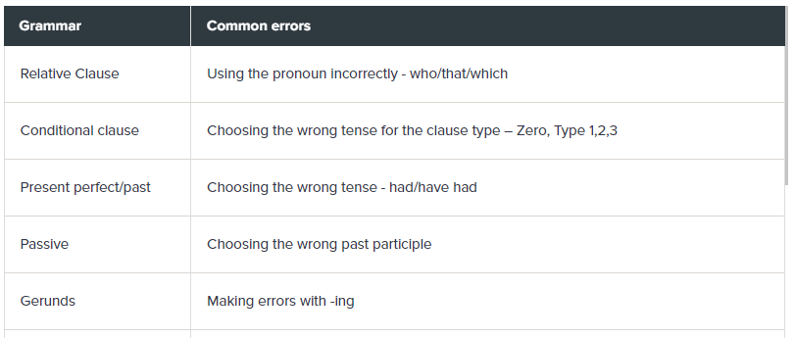
The most common errors made can be found below:

Slide 30
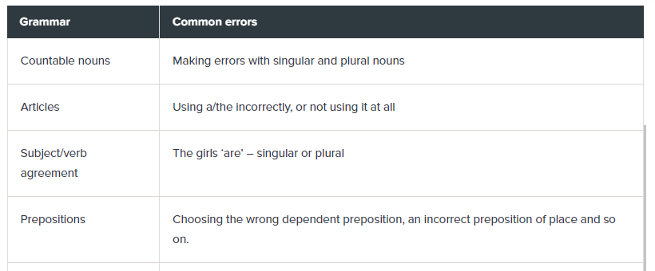

Slide 31
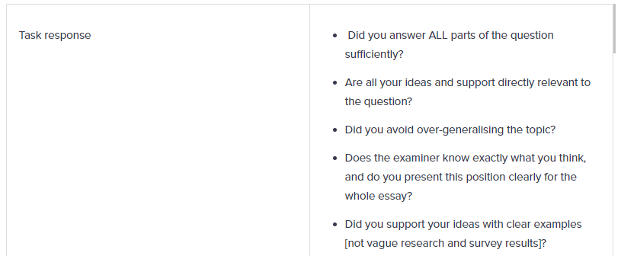
Step 8: Checklist
Use the following checklist to make sure that your writing contains all the positive features at a band 8

Slide 32
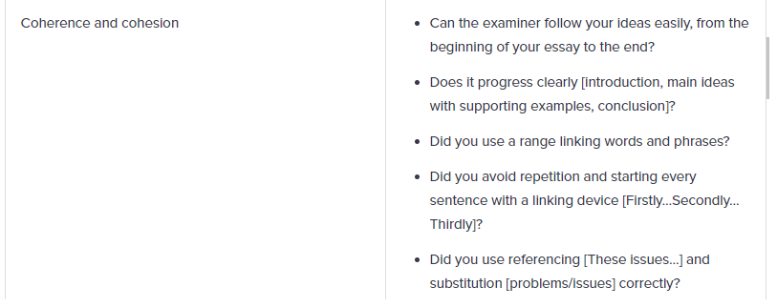

Slide 33
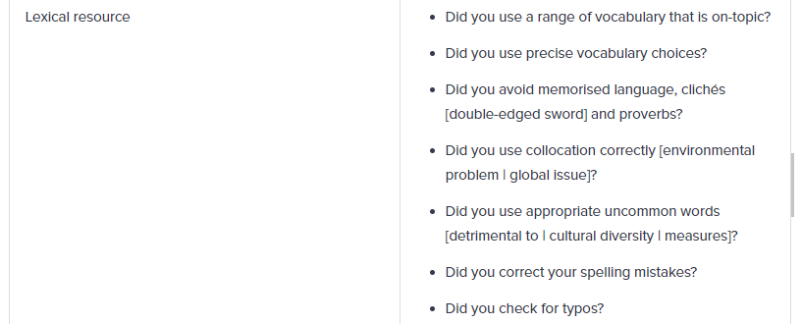

Slide 34
If you follow these 8 steps, you will be well on your way to a band 8 in Writing Task 2.

Slide 35
Thank You…!!!

