Slide 1
Book 13 Reading Passage – 2
Test - 1

Slide 3
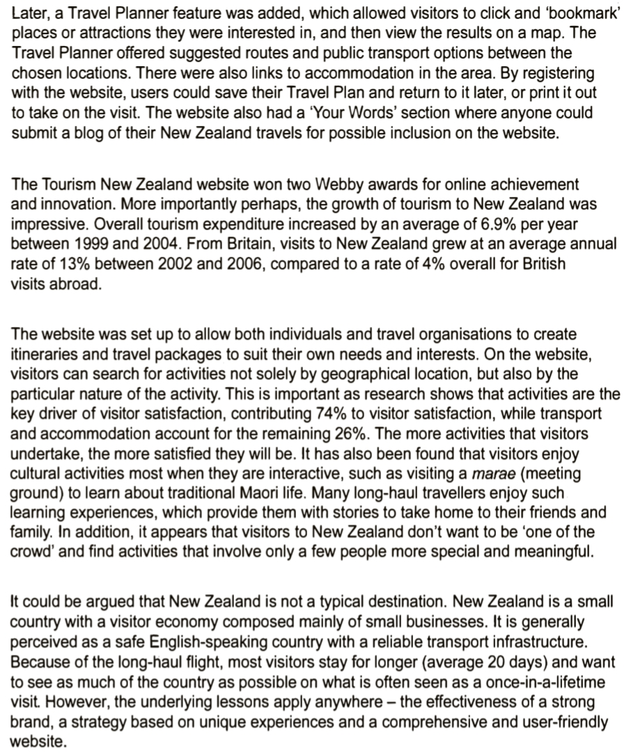

Slide 4
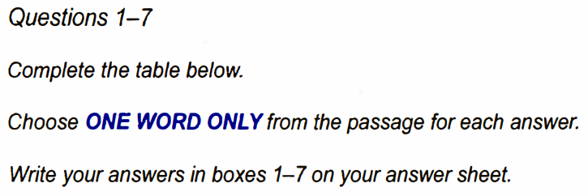
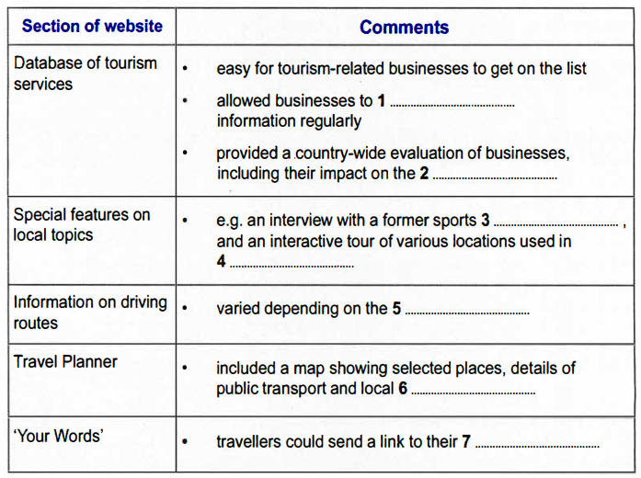

Slide 6
Thank You…!!!

