Slide 1
IELTS Academic Book 15 Test 1,2,3 & 4
Writing Tasks 1 Questions

Slide 2
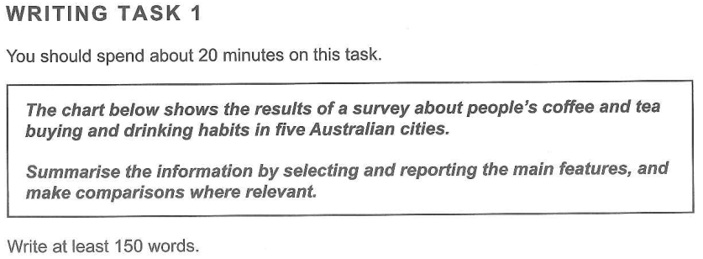
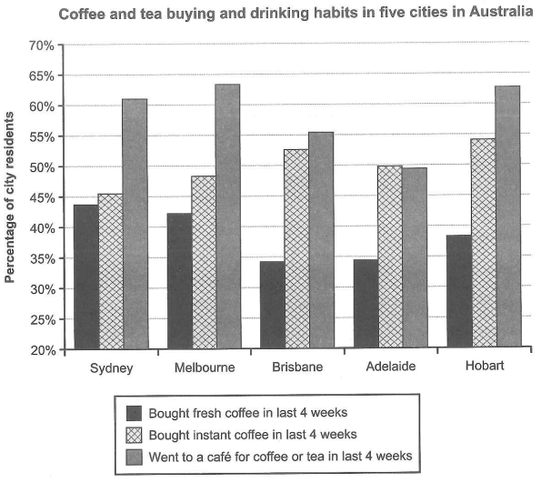
BOOK 15 – Academic – Test 1

Slide 3
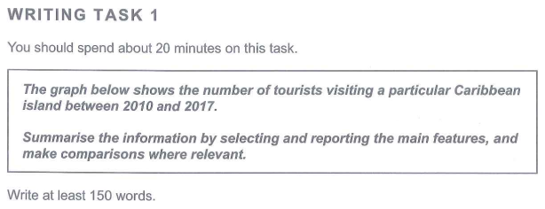
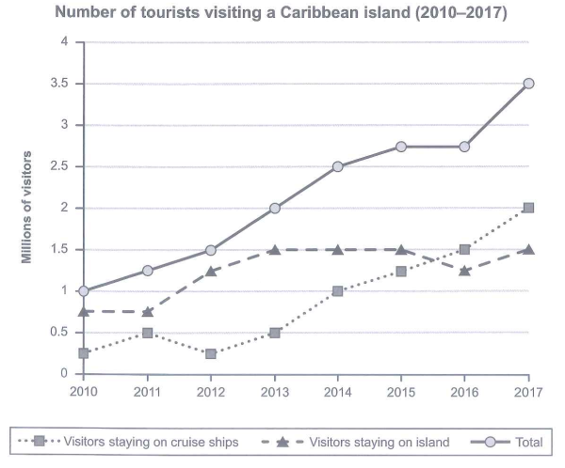
BOOK 15 – Academic – Test 2

Slide 4
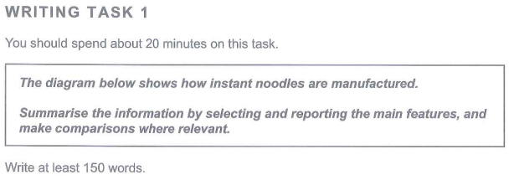
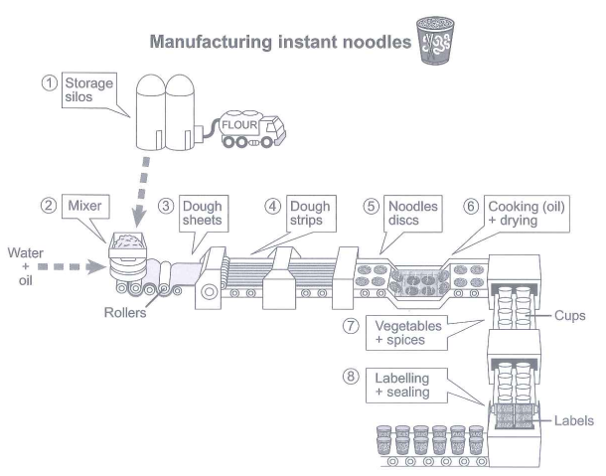
BOOK 15 – Academic – Test 3

Slide 5
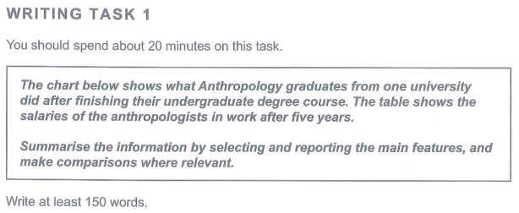
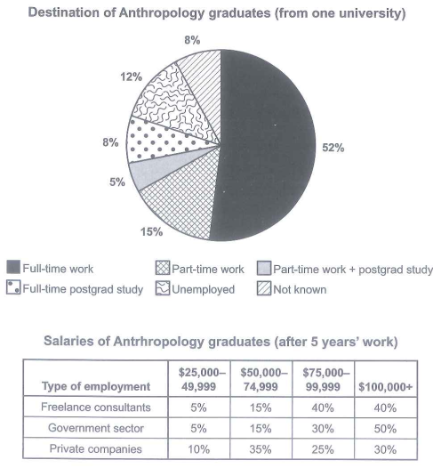
BOOK 15 – Academic – Test 4

Slide 6
Thank You…!!!

