Slide 1
IELTS Reading (Academic) Introduction

Slide 2
IELTS Reading (Academic)
The IELTS Reading Academic module consists of three passages totaling approximately 2,500 words. The passages are similar to the kind of articles you might read in a general interest magazine covering serious topics like Nature or The Economist.
You have 60 minutes in which to read the three passages and answer 40 questions.
The passages are not the same length and the number of questions after each passage varies, so careful time management is all-important in IELTS Reading.

Slide 3
IELTS Reading Overview.
The three passages in the IELTS Reading module deal with a range of academic subjects: one may be about ancient history, another about astronomy, another about advertising techniques, and so on.
Each passage in IELTS Reading is followed by 11 to 15 questions. You can read and answer questions at the same time. The questions are multiple-choice, matching, true/false/not given, sentence completion, or summary completion tasks. Write your answers in pencil on the separate answer sheet provided. You can also make notes on the question sheet.
The IELTS Reading module lasts 60 minutes. You should be able to skim-read approximately 170 words per minute and spend no more than 15 minutes in total reading the three passages. That will leave you around one minute to attempt each question plus a little extra time for checking.

Slide 4
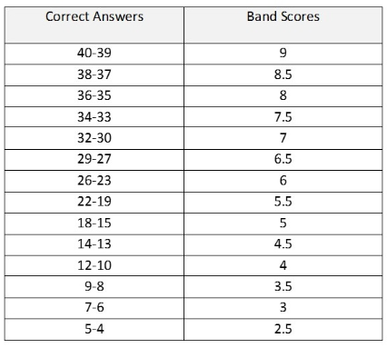
How IELTS Reading answers are scored
A human examiner marks your answers. You get one point for each correct answer, giving you a ‘raw score’ out of 40. This is converted into a ‘band score’ from 0 to 9. For example, you need 30 correct answers to get a band score of 7.0.

Slide 5
Five exam techniques for IELTS Reading
1. Skim-read quickly. Try to find the main idea of each passage and of each paragraph.
Don’t read all the supporting details. Ignore any unfamiliar words at this stage.
2. Identify keywords. Scan the passage and the questions for words you know will be in the
passage such as names of people, names of places, and dates.
3. Identify paraphrase. Look for similar meanings between what the passage says and what
the question asks.
4. Manage time. Some questions will be extremely difficult so you should concentrate first
on the questions that are easiest for you to answer. Take no more than 60 seconds to
consider your answer before moving on to the next question.
5. Expand your vocabulary. You will find the academic module of IELTS Reading much easier
if you expand your academic vocabulary. The academic word list is a great place to start.

Slide 6
Academic Reading sample task – Matching features
[Note: This is an extract from an Academic Reading passage on the development of rockets. The text preceding this extract explored the slow development of the rocket and explained the principle of propulsion.]
The invention of rockets is linked inextricably with the invention of 'black powder'. Most historians of technology credit the Chinese with its discovery. They base their belief on studies of Chinese writings or on the notebooks of early Europeans who settled in or made long visits to China to study its history and civilisation. It is probable that, sometime in the tenth century, black powder was first compounded from its basic ingredients of saltpetre, charcoal and sulphur. But this does not mean that it was immediately used to propel rockets. By the thirteenth century, powder-propelled fire arrows had become rather common. The Chinese relied on this type of technological development to produce incendiary projectiles of many sorts, explosive grenades and possibly cannons to repel their enemies. One such weapon was the 'basket of fire' or, as directly translated from Chinese, the 'arrows like flying leopards'. The 0.7 metre-long arrows, each with a long tube of gunpowder attached near the point of each arrow, could be fired from a long, octagonal-shaped basket at the same time and had a range of 400 paces. Another weapon was the 'arrow as a flying sabre', which could be fired from crossbows. The rocket, placed in a similar position to other rocket-propelled arrows, was designed to increase the range. A small iron weight was attached to the 1.5m bamboo shaft, just below the feathers, to increase the arrow's stability by moving the centre of gravity to a position below the rocket. At a similar time, the Arabs had developed the 'egg which moves and burns'. This 'egg' was apparently full of gunpowder and stabilised by a 1.5m tail. It was fired using two rockets attached to either side of this tail.

Slide 7
It was not until the eighteenth century that Europe became seriously interested in the possibilities of using the rocket itself as a weapon of war and not just to propel other weapons. Prior to this, rockets were used only in pyrotechnic displays. The incentive for the more aggressive use of rockets came not from within the European continent but from far-away India, whose leaders had built up a corps of rocketeers and used rockets successfully against the British in the late eighteenth century. The Indian rockets used against the British were described by a British Captain serving in India as ‘an iron envelope about 200 millimetres long and 40 millimetres in diameter with sharp points at the top and a 3m-long bamboo guiding stick’. In the early nineteenth century the British began to experiment with incendiary barrage rockets. The British rocket differed from the Indian version in that it was completely encased in a stout, iron cylinder, terminating in a conical head, measuring one metre in diameter and having a stick almost five metres long and constructed in such a way that it could be firmly attached to the body of the rocket. The Americans developed a rocket, complete with its own launcher, to use against the Mexicans in the mid-nineteenth century. A long cylindrical tube was propped up by two sticks and fastened to the top of the launcher, thereby allowing the rockets to be inserted and lit from the other end. However, the results were sometimes not that impressive as the behaviour of the rockets in flight was less than predictable.

Slide 9
Thank You…!!!

