Slide 1
Listening Tips
for your IELTS exam

Slide 2
Listening tips for your IELTS exam
Attempt all questions – there are no penalties for incorrect answers. Be careful to not waste time on a question that you don’t know though – guess and move on.
Watch out for plurals in answers. If the question requires a plural answer, a singular answer is incorrect.
Answers appear in the order they are heard in the audio. They come quickly or with large gaps between them.
Prepare to hear a potential answer that is not the actual answer. This is common when two people are making plans. They first agree on meeting at a certain time, but then one remembers that they cannot so they decide on a new time.
Take care when you transfer your answers and pay attention to the word limit for your answers on your answer sheet!

Slide 3
Listening tips for your IELTS exam
Multiple-choice answers will ask for a letter (a, b, c, d). Write the letter and not the corresponding answer.
When asked to complete a sentence using no more than two words, and the correct answer is “leather coat,” then “a coat made of leather” is incorrect. Same goes for numbers.
Hyphenated words (like “part-time”) are considered as one word.
A date (1990) is considered one number.
Focus on what the speaker is saying not how they say it.
Don’t take notes in complete sentences – jot down the key points and abbreviate. You only need to write down enough to help your memory later.

Slide 4
Listening tips for your IELTS exam
Get the habit of distinguishing between essential and non-essential information. If two people are talking about making plans for a dinner date, the important information is the date/time they finally agree upon. Other dates/times they considered become irrelevant.
Try to guess what the speaker is going to say. Speakers, will often drop clue words or outline what they will to talk about beforehand. This gives you the ability to start your own outline to then fill in.
Listen to the audio while reading the audio script. This will help you get a sense of how questions are spaced out, as well as learning some useful common expressions that are frequently used in listening tests. We often give this tip to students wondering how to improve listening in IELTS.

Slide 5
IELTS Listening tips to predict answers in the listening exam
You have the opportunity to read the questions before listening to the recording. Take advantage of this!
The questions can help you determine what type of answer you’re looking for. For example, if you have the following question:
“He would like to meet in ____________.”
The preposition “in” clues you into the type of answer you should be looking for.
The answer, in this case, has to be either a period of time (2 days), a month (April), a year (2018), or a season (Winter).

Slide 6
Here’s one of our favourite IELTS listening tips: Different prepositions will dictate different answers.
Here are some examples:
Preposition: AT
Possible answer: Time, Part of Day, Place
Examples: 9 pm, dawn, the restaurant
Preposition: IN
Possible answer: Period of Time, Month, Year, Season
Examples: 2 days/hour/minutes, April, 2018, Winter
Preposition: ON
Possible answer: Day, Date
Examples: Monday, January 15th (or 15th of January)
Preposition: no preposition
Possible answer: Person other
Examples: Emily now, at once, tomorrow, next year, this afternoon, person

Slide 7
What happens on the listening test?
The IELTS listening test is designed to assess how well you can:
Understand both main ideas and detailed information
Recognise the opinions and attitudes of a speaker
Follow the development of an idea or argument

Slide 8
Keep track of your results and improvement
For the reading and listening, take practice tests to see where you’re losing points.
Practice tests are great because they will show what areas of English are giving you trouble and where to focus your attention in order to improve.
Focus on your weak spots at first before branching out in a new direction!

Slide 9
IELTS Writing and listening simultaneously (a key skill!)
Writing while listening is hard if you aim to capture everything.
The key here is that it’s not always possible throughout the entire exam so don’t let this tactic take up too much time.
This will require you to develop your concentration skills and limit distractions even more so than before because you are now using both of these skills simultaneously.
Concentration skills can be improved through meditation and practice.

Slide 10
Reverse engineer the reading and listening tests
Find official IELTS exams. Cambridge is the best because they are usually slightly harder than the real test. Make sure you have the answer key. Some people sell it separately.
The Cambridge practice tests are also written by the same professionals who write the official exams.
Sit down with an exam paper and look at the answers first, and then look at the questions.
Work out how the questions are asked, what they ask and how.
This strategy for the IELTS listening test makes it far easier to find answers when you do the real test.

Slide 11
How is the IELTS Listening score calculated?
The IELTS listening exam tests English comprehension skills. The examiner looks to see whether you can listen to a piece of information and successfully answer questions.
The listening scores are out of 40 and are calculated based on the number of correct answers. Points are not taken away for incorrect answers.
Once you have completed the listening test you will be graded according to the following bandwidth ranging from a score of 4 to 9.

Slide 12
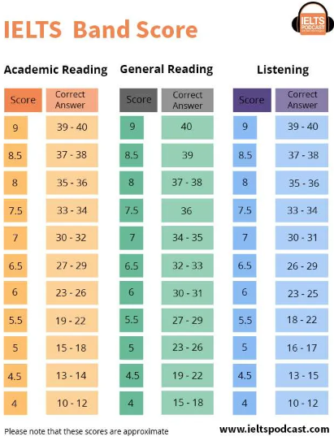

Slide 13
Five-step method for improving your listening skills for IELTS
Improving your listening skills requires active (not passive) listening practice. Focusing on understanding what you are listening to is important when you practice listening.
The best method to develop this skill is by combining listening and reading. Find audio examples with a text transcript to check your comprehension after listening.
Step 1: Listen to the audio clip (no reading)
See how much you can understand the general gist and start to pick out keywords.
Step 2: Repeat and repeat again (still no reading!)
Listen to the clip again. Based on what you understood the first time, is there now more that you can pick out?
Continue to listen to the clip several times to see if you can comprehend a little bit more each time.
Only move to step 3 when you’re not comprehending anything more from the audio. Your goal should be to understand as much as possible from the audio!

Slide 14
Five-step method for improving your listening skills for IELTS
Step 3: Read the text
Check your understanding and identify any new vocabulary. See if you can guess the meaning of any new words based on the context before looking them up.
Step 4: Listen with the text
Listen to the pronunciation of phrases and groups of words.
Step 5: Listen a few more times without the text
At this point, you should be able to understand the majority of the clip. Repetition makes it easier to understand the words and phrases when you hear them again.
As Ben W says: REPETITION IS THE MOTHER OF ALL LEARNING.
These steps were adapted from Benny’s great blog: FluentIn3Months

Slide 15
Five-step method for improving your listening skills for IELTS
Step 3: Read the text
Check your understanding and identify any new vocabulary. See if you can guess the meaning of any new words based on the context before looking them up.
Step 4: Listen with the text
Listen to the pronunciation of phrases and groups of words.
Step 5: Listen a few more times without the text
At this point, you should be able to understand the majority of the clip. Repetition makes it easier to understand the words and phrases when you hear them again.
As Ben W says: REPETITION IS THE MOTHER OF ALL LEARNING.
These steps were adapted from Benny’s great blog: FluentIn3Months

Slide 16
Thank You…!!!

