Slide 1
IELTS Listening Test - 1
Part 3

Slide 2
IELTS practice Listening Test - Part 3
This is the third part of your Listening test. Listen to the audio and answer questions 21-30.
Listen to the instructions for each part of this section carefully. Answer all the questions.
While you are listening, write your answers on the question paper.
Use a pencil.
When you have completed all four parts of the Listening test you will have ten minutes to copy your answers on to a separate answer sheet.
.

Slide 3
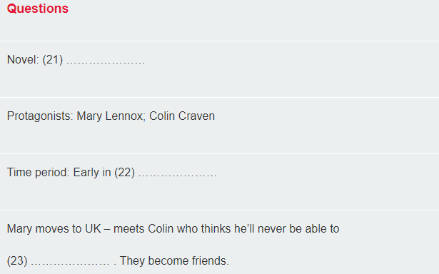
IELTS practice Listening test audio: Part 3
Questions 21–30
Complete the notes below. Write no more than three words for each answer.

Slide 4
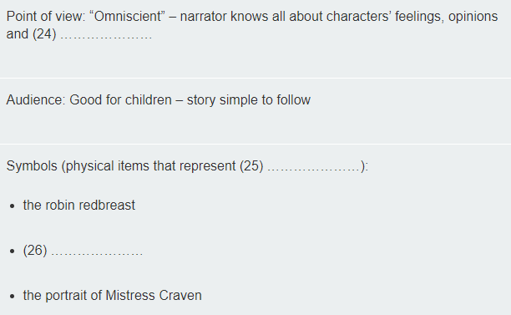

Slide 5
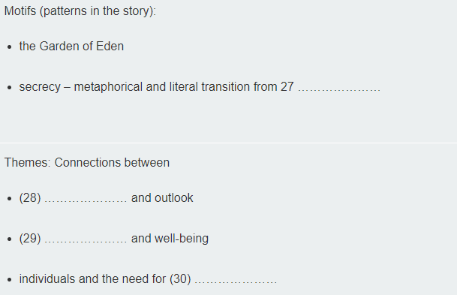

Slide 6
Thank You…!!!

