Slide 1


IELTS Reading Tips

Slide 2
The IELTS Reading test requires you to answer 40 questions in 60 minutes, so you must be fully prepared before you book your exam. In this video, I’ll show you exactly how to get the score you need in IELTS Reading.
1. Timing is key.
You will have just 1 hour to complete 40 questions, so you must use your time wisely. I advise my students to finish each section in 20 minutes. This will give you 16-17 minutes to read and answer the questions and 3-4 minutes to transfer and check your answers. You’ll find more help with time management here.
2. Read the instructions carefully.
Many strong candidates lose marks in IELTS Reading because they don’t read the instructions properly. Pay close attention to the instructions you’re given to avoid losing easy marks.

Slide 3
3. Don’t panic.
Some of the questions will be easy, and some will be extremely difficult. (I knew many IELTS teachers who had to check the answers to some questions because they are so challenging!)
The wrong thing to do is spend a lot of time on a hard question. If the answer does not present itself, move on to the next one. You can always come back to the difficult questions later.
You must stay calm and keep your nerves under control. Accepting that you are probably not going to get all the questions correct might help you control your nerves and timing on test day!
4. It’s really a vocabulary test.
In many ways, IELTS Reading is more of a vocabulary test than a reading test. The reason is that you need a wide range of vocabulary to understand the passages of text given to you. You must also be aware of synonyms and paraphrasing if you wish to identify the information required to answer the questions correctly.
5. Don’t expect to understand every word.
If you don’t understand a word in the test, you should look at the words and sentences around it for clues about its meaning. Alternatively, you can move on and forget about it.
Focus on the words that are related to the question, and don’t worry about the words you don’t understand.

Slide 4
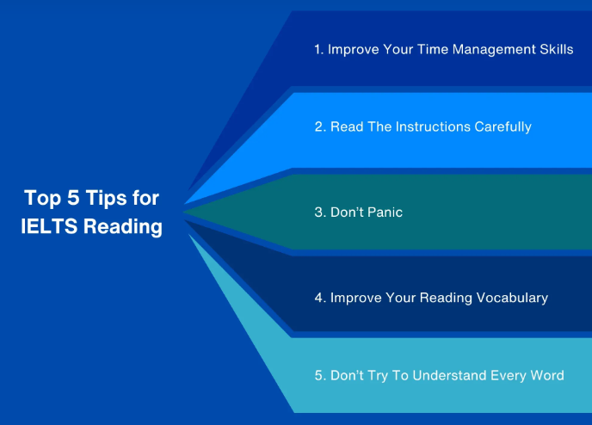

Slide 5
How to Get Band 9 in IELTS Writing Task
The IELTS writing task is often considered the toughest nut to crack in the IELTS exam, and if not attempted well, it can drop your overall band score. Therefore, students must ensure that they put in more effort for this particular section.
Some tips that can help you catapult your IELTS writing task score are:
Dedicate 20 minutes of your time to task 1 and about 30 minutes to the IELTS essay, which is task 2. You should use your remaining time to proofread and ensure that you haven’t made any inaccuracies, spelling errors, letter casing errors, or any other punctuation or grammatical errors.
Mention any familiar situations in the examples for writing task 2 to build coherence and refine the quality of your essay.
Read through sample answers of IELTS band 9 on common themes like fossil fuels, global warming, nuclear energy, etc., that have been taken up in writing task 2 again and again.

Slide 6
Conclusively, you are now in a good space to score an IELTS band 9 in each section after knowing about all the tips and tricks you need to use in the IELTS exam. However, simply knowing these tips doesn’t guarantee a high band score. To get a good score, you have to put in the effort and prepare well for the exam through sample tests, preparation modules, and consistent practice.

Slide 13
IELTS Reading (Academic): Introduction
The IELTS Reading Academic module consists of three passages totaling approximately 2,500 words. The passages are similar to the kind of articles you might read in a general interest magazine covering serious topics like Nature or The Economist.
You have 60 minutes in which to read the three passages and answer 40 questions. The passages are not the same length and the number of questions after each passage varies, so careful time management is all-important in IELTS Reading.
.

Slide 14
IELTS Reading Overview
The three passages in the IELTS Reading module deal with a range of academic subjects: one may be about ancient history, another about astronomy, another about advertising techniques, and so on.
Each passage in IELTS Reading is followed by 11 to 15 questions. You can read and answer questions at the same time. The questions are multiple-choice, matching, true/false/not given, sentence completion, or summary completion tasks. Write your answers in pencil on the separate answer sheet provided. You can also make notes on the question sheet.
The IELTS Reading module lasts 60 minutes. You should be able to skim-read approximately 170 words per minute and spend no more than 15 minutes in total reading the three passages. That will leave you around one minute to attempt each question plus a little extra time for checking.
.

Slide 15
How IELTS Reading answers are scored
A human examiner marks your answers. You get one point for each correct answer, giving you a ‘raw score’ out of 40. This is converted into a ‘band score’ from 0 to 9. For example, you need 30 correct answers to get a band score of 7.0.
You can't read every single line of the reading passages and then answer the questions as time will be against you then. You need to use scanning, skimming, guessing, eliminating wrong answers, etc techniques to find the answers to these questions. You are allowed to mark and make notes in your reading question booklet, but you will have to write your answers on the answer sheet. No extra time will be given to transfer the answer.

Slide 16
Five exam techniques for IELTS Reading
1. Skim-read quickly. Try to find the main idea of each passage and of each paragraph. Don’t read all the supporting details. Ignore any unfamiliar words at this stage.
2. Identify key words. Scan the passage and the questions for words you know will be in the passage such as names of people, names of places, and dates.
3. Identify paraphrase. Look for similar meaning between what the passage says and what the question asks.
4. Manage time. Some questions will be extremely difficult so you should concentrate first on the questions that are easiest for you to answer. Take no more than 60 seconds to consider your answer before moving on to the next question.
5. Expand your vocabulary. You will find the academic module of IELTS Reading much easier if you expand your academic vocabulary. The academic word list is a great place to start.

Slide 17
IELTS Reading Test
Understand the IELTS Reading test format and questions. Achieve a good band score in the IELTS Academic or General Training Reading test with our IELTS Reading practice materials.
About IELTS Reading test
IELTS Reading assesses a variety of reading skills, and while the question structures are identical for the Academic and General Training tests, the text styles are different. There are three sections to the Reading test, and you will have about 60 minutes to respond to 40 questions.
Test format
The 40 questions on the IELTS Reading test evaluate a variety of reading skills. These include:
Skimming - reading for gist and to understand the main idea
Scanning - reading quickly to locate a specific piece of information
Reading for detail – reading to understand a logical argument, opinions, attitudes, and the writer’s purpose.

Slide 18
Time limit during IELTS Reading test
You have 60 minutes to complete 40 questions, so managing your time is crucial. There are three sections in the Reading test, and you should aim to spend no more than 20 minutes on each section. As the test progresses, the sections increase in difficulty, so make sure you allow yourself enough time to complete each of the sections. You may find you are able to get through the first section more quickly, giving you more time to spend on the more challenging questions in the next two sections.
How to prepare for IELTS Reading?
The IELTS score you need can be achieved by preparing yourself well in advance of the test. Check out our website's extensive collection of IELTS Reading practice tests, professional videos, and other IELTS preparation materials.

Slide 19
IELTS Reading practice
Take a closer look at our IELTS Reading practice materials and get a better idea of the questions you might encounter on the test day by skimming through the IELTS General Training Reading practice materials and IELTS Academic Reading practice materials.

Slide 20
IELTS General Training Reading
There are three sections and 40 questions in the General Training Reading test. It focuses on scenarios that you may encounter in your daily or professional life, such as general topics of interest or applying for jobs. All the texts used in the General Training Reading test are derived from books, magazines, newspapers, advertisements, company handbooks, and guidelines.
Section 1 looks at your social survival skills and will contain a few short texts that are relevant to daily life in an English-speaking country. These could be timetables, advertisements, or notices.
Section 2 takes a closer look at your workplace survival skills. The texts used here are taken from contracts, staff development and training manuals, job descriptions, contracts, and salary and working condition documents.
Section 3 contains a lengthy and more complicated text on a topic of general interest. This text could be taken from a book, magazine, or newspaper.

Slide 21
IELTS Academic Reading
The Academic Reading test evaluates a variety of reading skills, including your ability to follow an argument and identify the opinion, attitude, or intent of a writer. It assesses your ability to understand ideas, details, opinions, and implicit meanings when reading. Skimming, scanning, and detailed reading are all included in the evaluation of your reading comprehension skills.
Three sections, each of which contains a long text taken from current books, journals, magazines, and newspapers make up the Academic Reading test. The texts are based on issues you would encounter in an educational or professional context in an English-speaking setting.
The Academic Reading test consists of 40 questions that you must answer. These can include short-answer questions, matching headings or sentence endings, identifying information, and completion tasks such as sentence, summary, note, table, and flow-chart completions.

Slide 22
Academic and General Training question types
In the General Training and Academic Reading tests, you can expect a range of question types, including:
Identifying information
Multiple choice
Identifying a writer's views/claims
Matching headings
Matching information
Matching features
Matching sentence ending
Sentence completion
Summary, note, table, flow-chart completion
Diagram label completion
Short-answer questions
You will need to manage your time to make sure you can respond to a variety of question types in the given 60 minutes.

Slide 23
.
IELTS Reading band scores
In the Reading test, you will receive one mark for each correct answer. Your raw score—which is used to calculate your band score—will be based on the total number of correct answers. It is crucial to try to respond to every question because a blank response will get no marks.
In the IELTS Reading test, you will have 40 questions to answer over the three sections. There is just one right answer for each question. Each correct response will get you one mark. Your band score for the Reading test will be determined by the total number of points. Your overall IELTS band score is calculated using this score.
You can also check out some of the free IELTS practice tests, as well as free IELTS General Training Reading practice questions to help you prepare for your IELTS test.

Slide 24
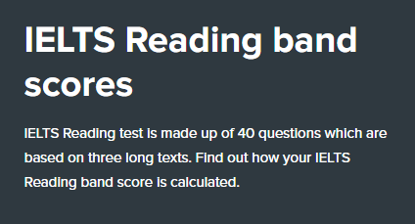
How is the IELTS Reading score calculated?
The Academic and General IELTS tests have different reading sections. However, the question types, the number of questions, and the way it is scored remains the same. The question types range from multiple choice and matching information tasks, such as matching sentence endings or headings, to completion tasks such as summary, flow-chart or sentence completion.
In the Reading test, you will respond to 40 questions that are based on three long texts, and you will receive one mark for each correct answer. Your raw score—which is used to calculate your IELTS band score will be based on the total number of correct answers. It is crucial to try to respond to every question because blank answers will not receive points.

Slide 25
The IELTS Reading test comprises of 3 paragraphs, for which you will get a total of 60 minutes to complete. To complete the test within the stipulated time, you're advised not to spend more than 20 minutes on each passage. This section has 40 questions with each question carrying 1 point, and no negative marking for wrong answers. The questions fall under different question types which are explained elaborately further down the page. Please do keep a check on your spellings, as an incorrect spelling would be considered an incorrect answer.
Practise IELTS Reading
Here are our practice tests for IELTS General and Academic. Solve them as you would do in the real exam. You may unlock and check your answers once you're done. Give them a shot to ace the IELTS with a band 8+.
How to ace the IELTS reading section
Before we move on to the open secret of how to ace the IELTS reading section, let's get introduced to two important reading techniques.

Slide 26
Skimming & Scanning
Skimming is to read a text rapidly to get a general overview of the material (i.e) to know the main theme or idea behind the passage. Scanning is to read a text rapidly to find specific information such as figures, names, etc. Moving on to the next section, here are the steps to help you get the high band you're aiming for in reading:
Skim the passage - Skim the passage to know what the general idea behind the passage is.
Read the question and identify the type of question - Each question falls under a question type (this is elaborated further down the page). Read the question and identify which question type it belongs to.
Remember the technique behind the question type - Each question type follows a strategy which helps us find the answers easily ( also explained further down). Recall the technique and find the answer according to it.
Find the keyword - Each question would have a keyword that can be found somewhere in the passage. Discover this keyword and locate the keyword in the passage.
Read around the keyword - Once you've located the keyword, read around the keyword (i.e) read a few sentences before and after the keyword to find the answer.
Learn to guess the meaning - Know how to guess the meaning from the context given in the passage.
Write the answer - Find the answer and write it down. Move on to the next question quickly, as we don't have much time.
REPEAT!

Slide 27
What else can I do to improve my reading skills?
You can prepare for your IELTS reading test by reading English texts such as newspapers, books or journals regularly. This will help you improve your vocabulary as well as your grammar. You can start practising by reading IELTS reading materials and then with time, also create a habit of reading English newspapers, magazines, journals on a day-to-day basis. You can further prepare yourself by learning about the type of questions that could be posed in the test.
In this particular page, you’ll find a plethora of IELTS Reading passages for practice. By solving these practice questions, you can measure your preparedness for the exam. You can also get to know the areas where you make the maximum mistakes.
Also, you will find some details on the types of questions that are commonly given in IELTS Reading and some quick tips on how to tackle them. So, go through the double dose of information and get going on your preparation!
Follow the procedure given below to calculate your IELTS reading band score.
Choose a particular IELTS Reading practice test and click on the first section of the test.
Read the given IELTS reading passage and answer the questions given below it.
Go to the next section and repeat the same procedure.
Complete reading all the 3 passages and answer all the questions. Look at the ‘Answers’ section to check the scores obtained in the reading test.

Slide 28
As you know that based on the purpose of migration, there are two types of IELTS tests, IELTS Academic and IELTS General. The IELTS General Training Test is for applicants who wish to travel for the purpose of working or joining a non-academic form of training in an English speaking country.
Between IELTS Academic and IELTS General Training, the Reading and Writing sections differ. While the former is based on scholarly topics and is comparatively harder, the subjects for the latter are more straightforward and based on general topics.
In this post, we’ll be looking at the IELTS General Reading Practice Tests.
IELTS General Reading Practice Test
For the IELTS General Reading Test, you’ll be allowed 1 hour to complete 3 sections.
Section 1 will contain 2-3 short texts, with the topic being related to everyday life in an English speaking country.
Section 2 will contain short texts, mainly focusing on work-related issues (job hunting, job applying, company policies)
Section 3 will include a long, more complex text on a general topic that will be taken from guidebooks, advertisements, company handbooks, newspapers or notices.
While doing the IELTS general reading practice test, time yourself so that you complete it in an hour. There will be 40 questions in the test with each question carrying 1 mark.

Slide 29
Exam Time Duration
IELTS Reading Test time: You’ll have to complete the exam of 40 questions in one hour, where you have to write your answers directly on the answer sheet and no extra time will be given.
Types of Questions
For the IELTS General Reading test, a variety of questions are used, so it is good to get prepared for them
Types of questions that can be asked:
Multiple-choice
Short-answer questions
Matching Information
Identifying information
Matching headings
Sentence Completion
Table Completion
Flow-chart
Diagram Labelling

Slide 30
Things to remember while taking the test
Some tips to remember while writing the test
Read the instructions carefully
Before attempting the question it is important to understand the instruction given. For example, if only a one-word answer is asked, then the answer should be only in one word.
Forget what you already know about the topic
Remember, you’re being tested based on your understanding of the text and not based on your knowledge of the topic. So write your answer only based on the information given in the text.
Don’t leave blank spaces
Try to attempt every question and don’t leave out any questions even if you’re unsure.
Watch the time
Make sure to keep an eye on the time while writing as you have to complete all 40 questions in under an hour. So use the time wisely.

Slide 31
Don’t expect to understand every word
It’s okay if you don’t understand all the words in the question, don’t panic! Try to read the line again and understand what the situation is to have an idea of what that particular word might translate to.
Instructions were given to candidates
The instructions that will be given to the candidates during the actual test are:
Don’t open the question paper until told.
Write your full name and candidate number at the top of the page
Attempt all the questions.
Write the answers on the answer sheet; use a pencil
No extra time will be awarded.

Slide 32
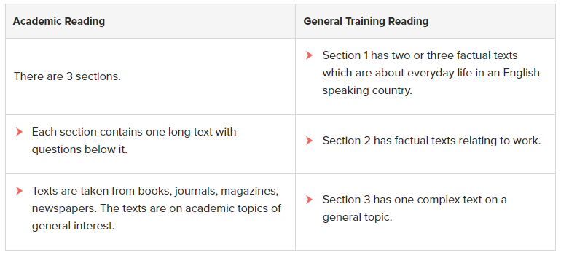
Difference between Academic Reading and General Training Reading
Even though the time, question types and number of questions given for both the sections remain the same, these sections do differ according to the tests taken.

Slide 33
The IELTS Academic Reading section is divided into 3 parts with each of these parts consisting of a long paragraph text. The difficulty level increases from part 1 to part 3. These texts are usually related to subjects like science, sociology and can even be some form of illustration. The IELTS General Training section is also divided into three parts. Part 1 and 2 of this section will have one or two texts and Part 3 will contain a long difficult passage on a general topic of interest. Part 1 of this section has texts related to everyday life, courses or some kind of service provided. Part 2 of this section has texts related to jobs, application procedures, etc. As IELTS General Training Reading section is easier than the IELTS Academic Reading section, the scores vary accordingly too. More questions need to be answered correctly on a General Training section to receive the same grade as an Academic Reading section. The band scores are calculated as follows for the Academic and General training sections respectively:

Slide 34
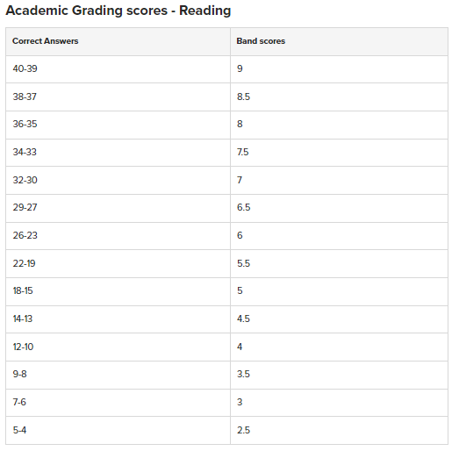
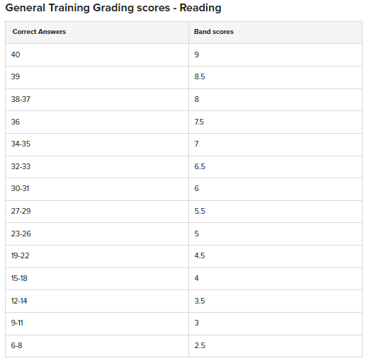
.

Slide 35
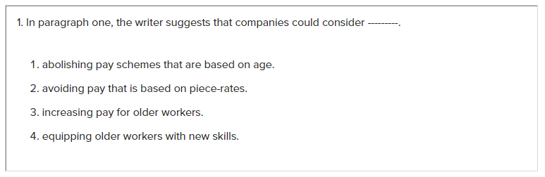
Types of questions in IELTS Reading
There are different kinds of questions for each of the passages that appear in the IELTS reading examination.
1. Multiple Choice Questions:
IELTS reading multiple choice questions have about 3-4 options from which we have to choose our answer. This might be in the form of a question & answer type or a choose a correct ending to a sentence type. These answers appear in chronological order according to the passage. Here is a sample of a multiple-choice question:

Slide 36
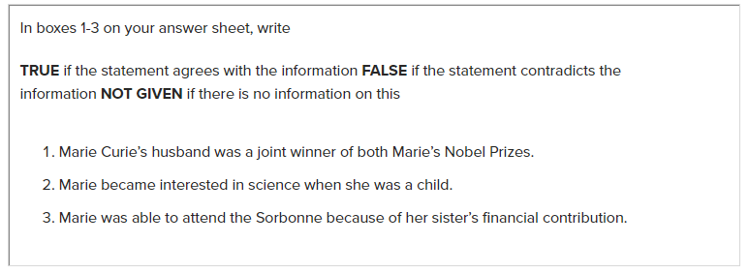
2. True/False/Not given Questions:
These questions are very tricky. This question consists of several statements:
If the statement is present in the article as it is then you need to mark it as true.
If the statement is found to be the opposite of the sentence which is there then it should be marked as false.
If the statement given in the question is not at all present in the article then it should be marked as not given. Do not spend a lot of time finding the sentence which is not there.
Here is a sample of a true/false/not given question:

Slide 37
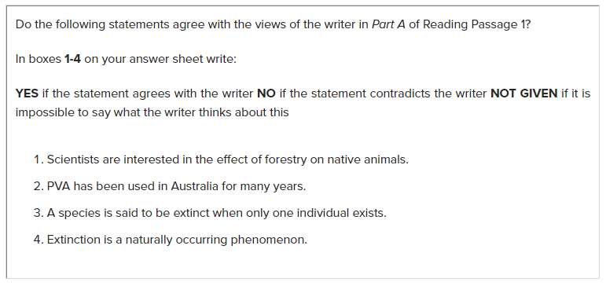
3. Yes/No/Not given Questions:
Similar to the True/False/Not given questions, Yes/No/Not given questions also have various statements. But here you are asked to agree or disagree with the statement based on the opinion of the author. Here is a sample of a Yes/No/Not given question:

Slide 38
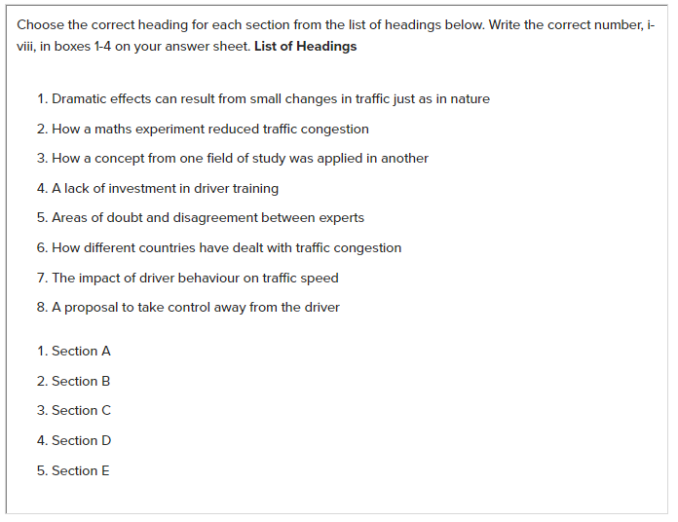
4. Matching Questions:
There are various types of matching questions in IELTS reading tests and each one is different from another.
4(a) Matching Headings:
In this type of question, a list of headings will be given and you are asked to match these headings with a paragraph in the passage. You should read the headings before you begin reading the text. To get the correct answer, you have to read the complete paragraph and not just stop with the first few lines of the paragraph. There will also be many other headings that are not related to any of the paragraphs given in the passage, in such cases, try to identify those types of headings too. Here is a sample matching headings question:

Slide 39

4 (b) Matching information:
Matching Information questions have a list which contains information taken from the paragraphs. You are asked to find out the paragraph from which the information is taken. Sometimes the question may be tricky because the information given might not be in exact words as given in the paragraph instead it will be paraphrased so you need to read the paragraph to understand the meaning/idea behind it to answer these questions. Here is a sample matching information question:
What was the children’s most frequent response when asked where the rain forests were?
What was the most common response to the question about the importance of rain forests?
What did most children give as the reason for the loss of the rain forests?
Why did most children think it important for the rain forests to be protected?
Which of the responses is cited as unexpectedly uncommon, given the amount of time spent on the issue by the newspapers and television?

Slide 40
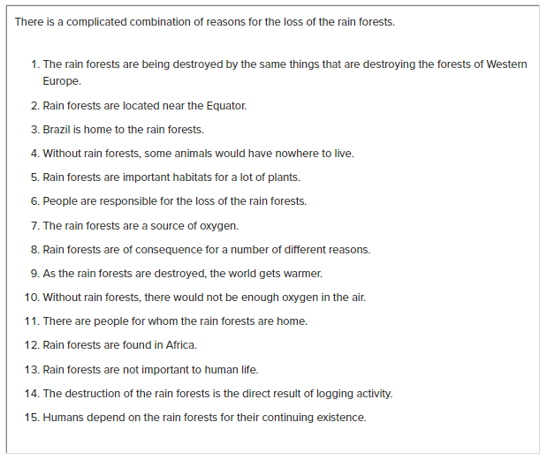
.

Slide 41

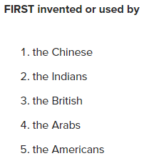
4 (c) Matching Features:
In this type of question, there will be a list of items in the box and you need to match these items by reading and understanding some sentences in the passages. The list may be of the name of people or cities. For example, If there is a name of a person in the box of items then the question may be to match the sentence with the person who said them. Like other types of match questions, some of the items mentioned may not be available in the passage. So, to save time read the passage before answering each question. Here is a sample matching features question:
black powder
rocket-propelled arrows for fighting
rockets as war weapons
the rocket launcher

Slide 42

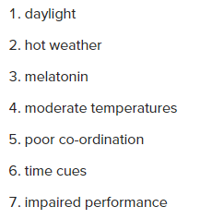
4 (d) Matching sentence endings:
In this type of question, you need to connect two halves of the sentences. The first half of the sentence will be already given you need to find out which is the appropriate ending for the sentence from the list given. While choosing from the list you need to keep the following things in mind:
There should not be any grammatical errors in the sentence.
The ending sentence chosen by you should make sense
The sentence should have the same meaning as the sentence in the passage.
It has been established that social tension increases significantly in the United States during .......
Research has shown that a hamster’s body-weight increases according to its exposure to.......
Animals cope with changing weather and food availability because they are influenced by.......

Slide 43
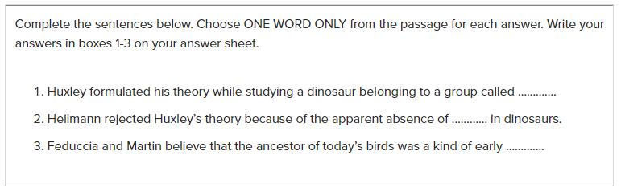
5. Sentence completion and Short-answer Questions
IELTS Reading Sentence completion and Short answer questions are almost similar. In sentence completion, you’ll be asked to fill in the blank spaces using the words given in the text. Whereas, in short answers, you’ll have to take words from the given text to write the short answers. It is important to pay close attention to the instructions that are given in the question because in some instructions there will be a word limit mentioned and you may lose marks if you don’t follow it. Here is a sample sentence completion question:

Slide 44
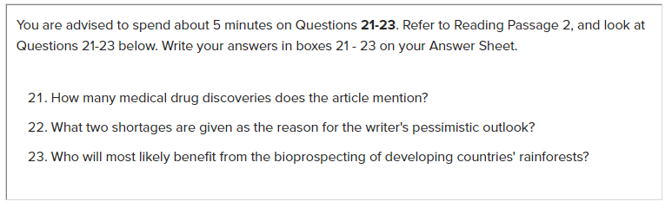
Here is a sample short answer question:

Slide 45
6. Note, Table, Diagram and Summary Completion Questions
In Note, Table, Summary and Diagram completion questions, you will be asked to complete a set of notes, tables, diagram or a summary based on the information given in the text. Sometimes the question will be to write a short answer and sometimes you’ll have to choose from the list of answers given. Usually, these kinds of questions will only be based on one part of the passage, so you won’t have to read the whole passage to fill in the important information.

Slide 46
.

Slide 47
.

Slide 48

Thank You…!!!

