Slide 1


IELTS Listening Test

Slide 2
IELTS Listening Test
Test format
In IELTS, there are four papers: Listening, Reading, Writing, and Speaking.
There are two different IELTS modules: Academic and General Training. The Speaking and Listening tests are the same in both modules, but the Reading and Writing tests are different.
What’s in the IELTS Listening paper?
The paper has four parts, with ten questions in each part. The questions are in the same order as the information in the recording, so the answer to the first question will be before the answer to the second question, and so on.

Slide 3
Parts 1 and 2 deal with everyday, social situations. There is a conversation between two speakers in Part 1 (for example, a conversation about travel arrangements). Only one person speaks in Part 2 (for example, a speech about local facilities).
Parts 3 and 4 deal with educational and training situations. In Part 3 there is a conversation between two main speakers (for example, two university students in discussion, perhaps guided by a tutor). In Part 4 only one person speaks on an academic subject.
You will hear the recordings once only. Different accents, including British, Australian, New Zealand, and North American, are used.
You will need to transfer your answers to an answer sheet. You will have 10 minutes at the end of the test to do this. You should be careful when writing your answers on the answer sheet because you will lose marks for incorrect spelling and grammar.

Slide 4
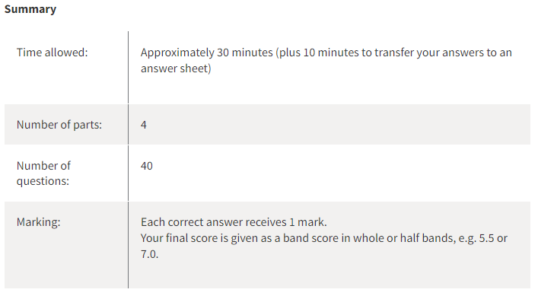

Slide 5
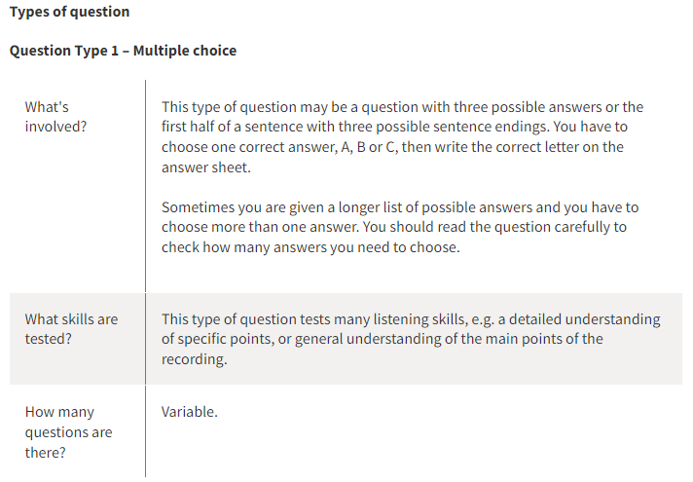

Slide 6
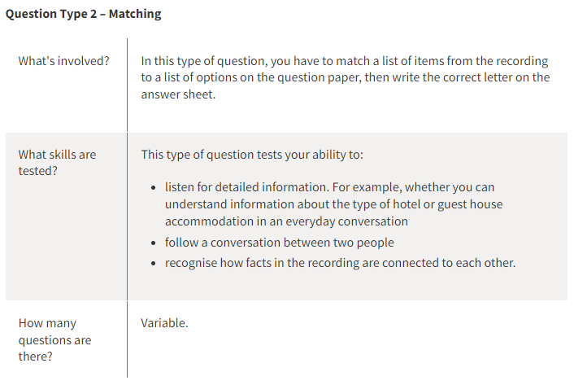

Slide 7
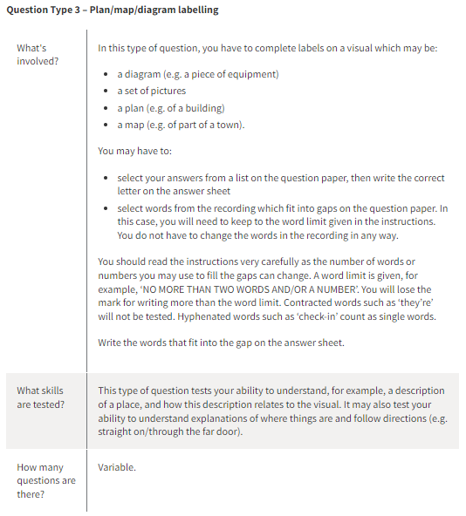

Slide 8
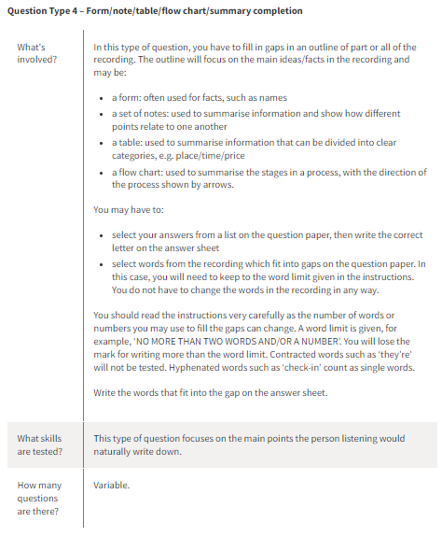

Slide 9
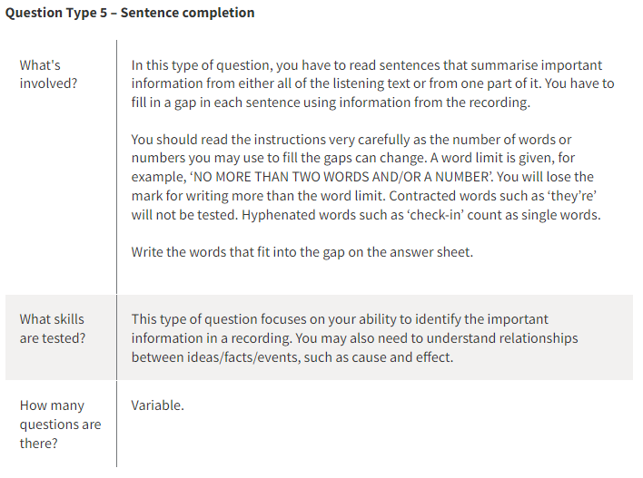

Slide 10
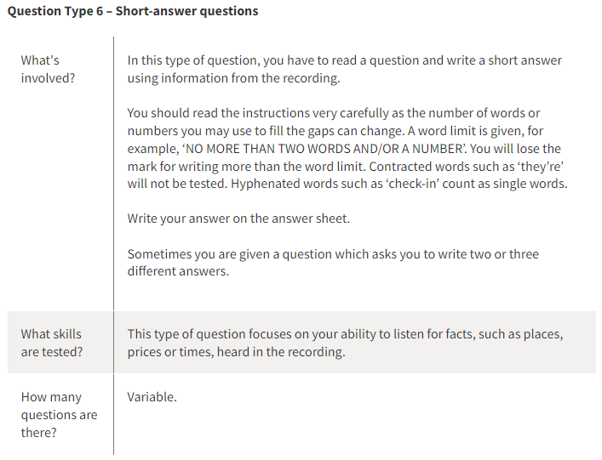

Slide 11

Thank You…!!!

